Slide 1

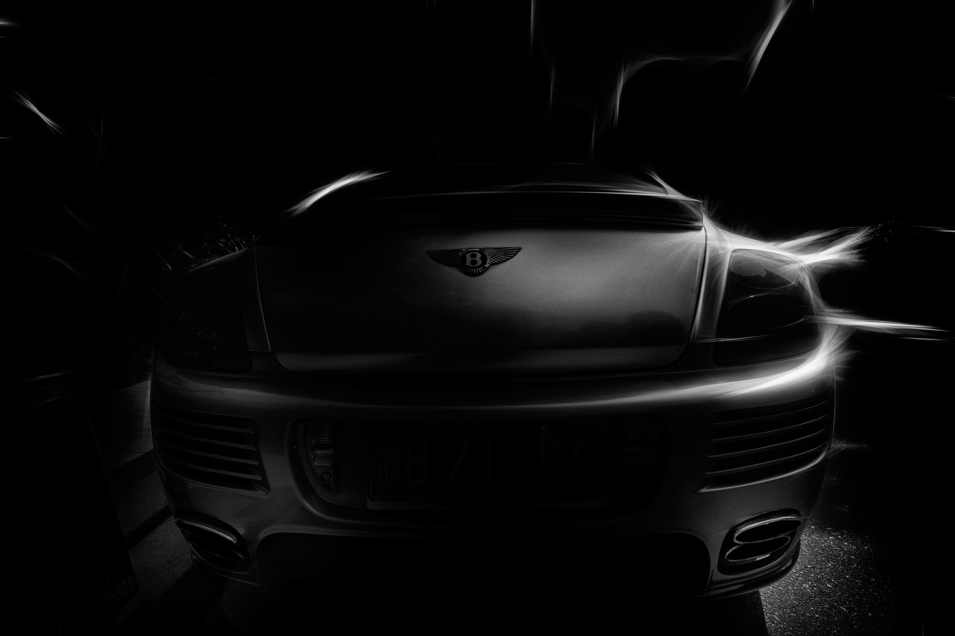
Consalting of
Used car in Germany
Blessed Consulting Company
Guanhong Chen 466763

Slide 2

CONTENTS
Self-introduction
The preference
1
3
The dataset
2
4
Recommendations

Slide 3
1
Self Introduction

Slide 4
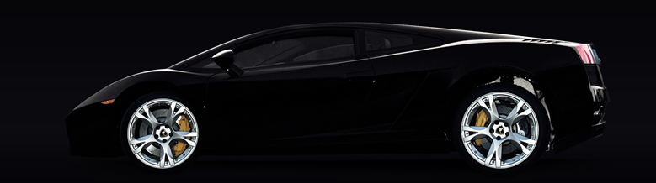
Guanhong Chen
Experience
Career
Over 8 years’ experience of Car repair and modification
Working in Hongqi for more than 5 years
I think I will be the best choice for your consulting
Got great car knowledge in Chinese and EU car market
Working in car consulting for over 3 years

Slide 5
2
The Dataset

Slide 6
Datasef From Kaggle
Data include from 2011 to 2025 sale cars in Autoscout24 in DE
Dtaset including all the variables we need for like gearbbox,fuel,mileage,brand,models....
Data cleaning manually to make sure all the data is correct and no outliers

Slide 7
3
FORMAL ANALYSIS

Slide 8
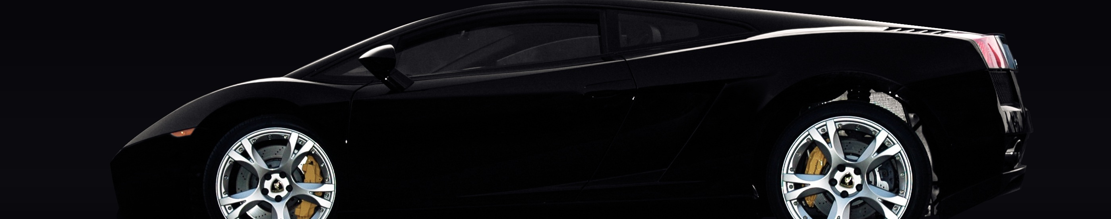
Maily Factors
01
The Important Factor we choose
1.Brand Well Sold
2.The Price
3.Gearbox Type
4.Horsepower
5.Year
6.Mileage
7.Fuel

Slide 9
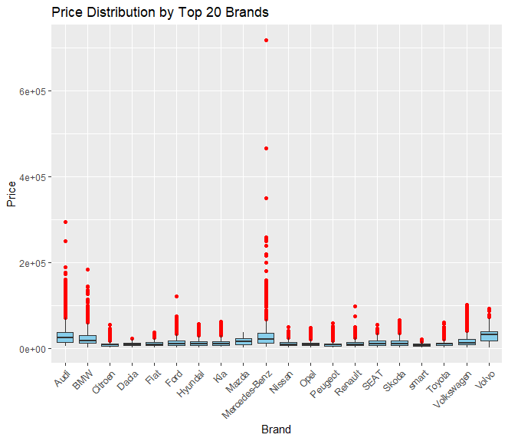
Brand
The most favorite brand ?
Germany Brand
Japanese and Korean Brand
French Brand
Price Distribution of them?
Maily for the low price
Meaning?
The more sale of the cars means : easy to accept the brand. easy to do the maintain and repaire easy to get the leagal docunment

Slide 10
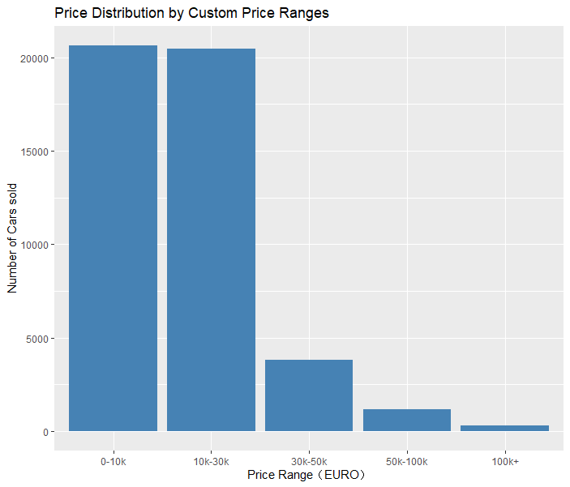
Price
The most normal price ?
Maily from 0-10 k and 10-30k EUROs
Price Distribution of them?
0-30k can take the mainly part of the distribution. So choose the car between these price.
Meaning?
The most popular and well-sold car should be the 0-30k price of cars.The luxury used car will be difficult to sold there.

Slide 11
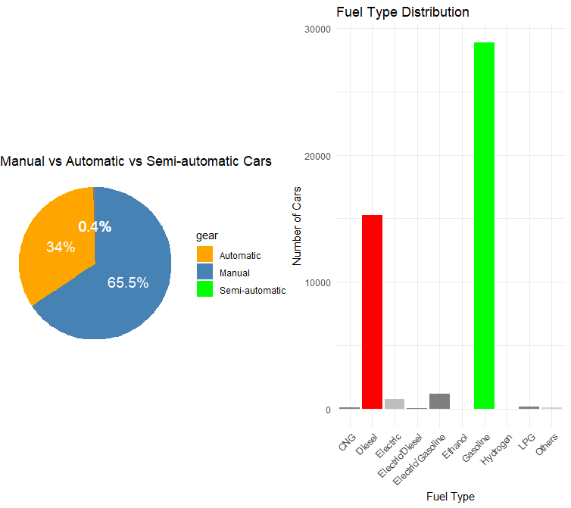
Fuel and Gearbox
The main type?
Manual with Gasoline
Advice?
Obviously because of the output policy and restriction of the car pollution,it would be more popular for the gasoline.
But about the gearbox,cause the equippment of the cars in China’s market is different in here.So all the manual and reliable automatic will be good choice if it’s in the right price.

Slide 12
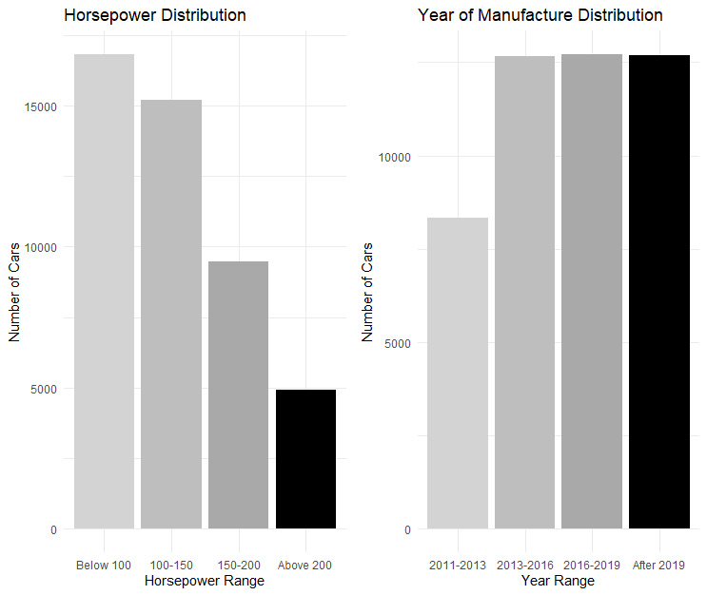
Fuel and Gearbox
The main type?
The car normally average sale between 2011 to now. Normally the hoursepower is between the 0-150.
Advice?
For Germen the age of the car in 15 years is not a big deal.So the car would be available for 15 years and will be easy to be accepted.
About the horsepower also shows the favorite type of Germany :mainly for daily using family car with samll-displacement .Because of the expensive fuel price.

Slide 13

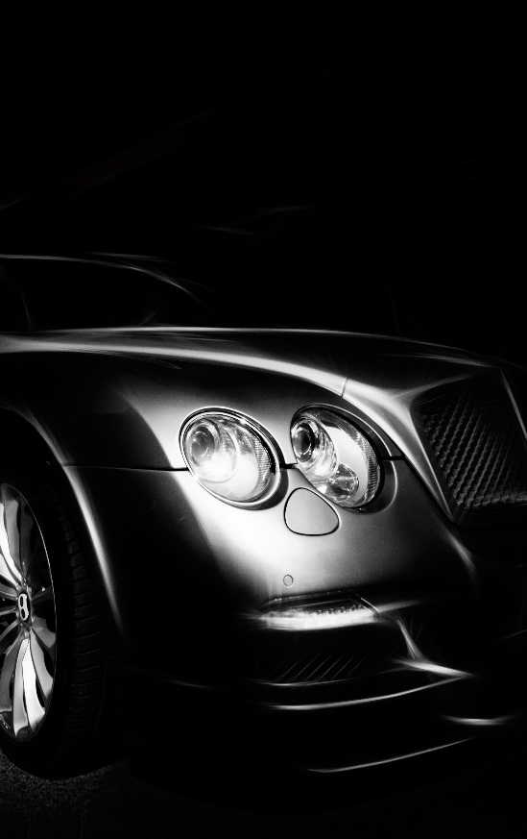
Key Words
What will be the important factors to choose the used car to sale here?
Price lower than 30000 euros Especially for lower than 10000euros
Germany,Japanese,Korean,French Brand
Manual Gasoline
Small-displacement family car 0-15 years old cars

Slide 14
4
Recommendations

Slide 15
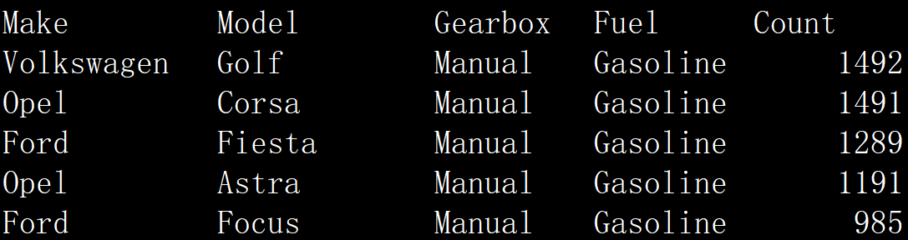
The top5 well-sold cars

Slide 16
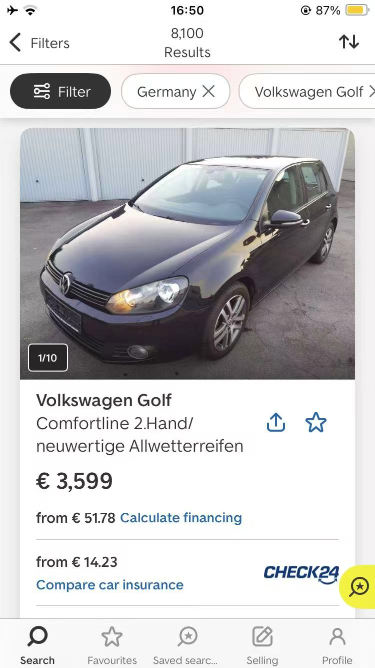
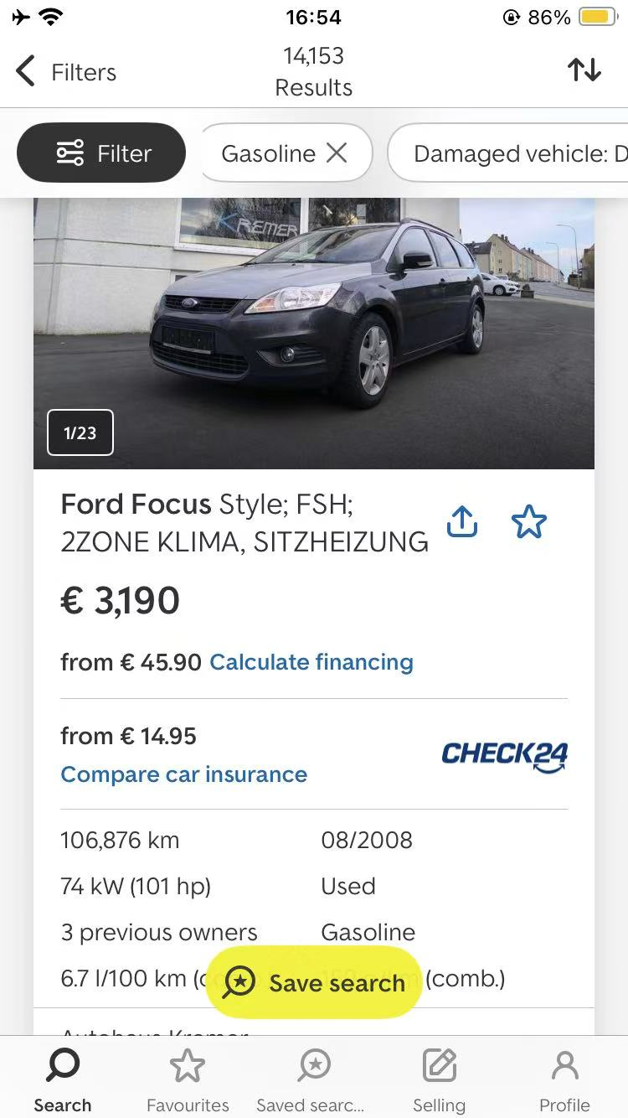
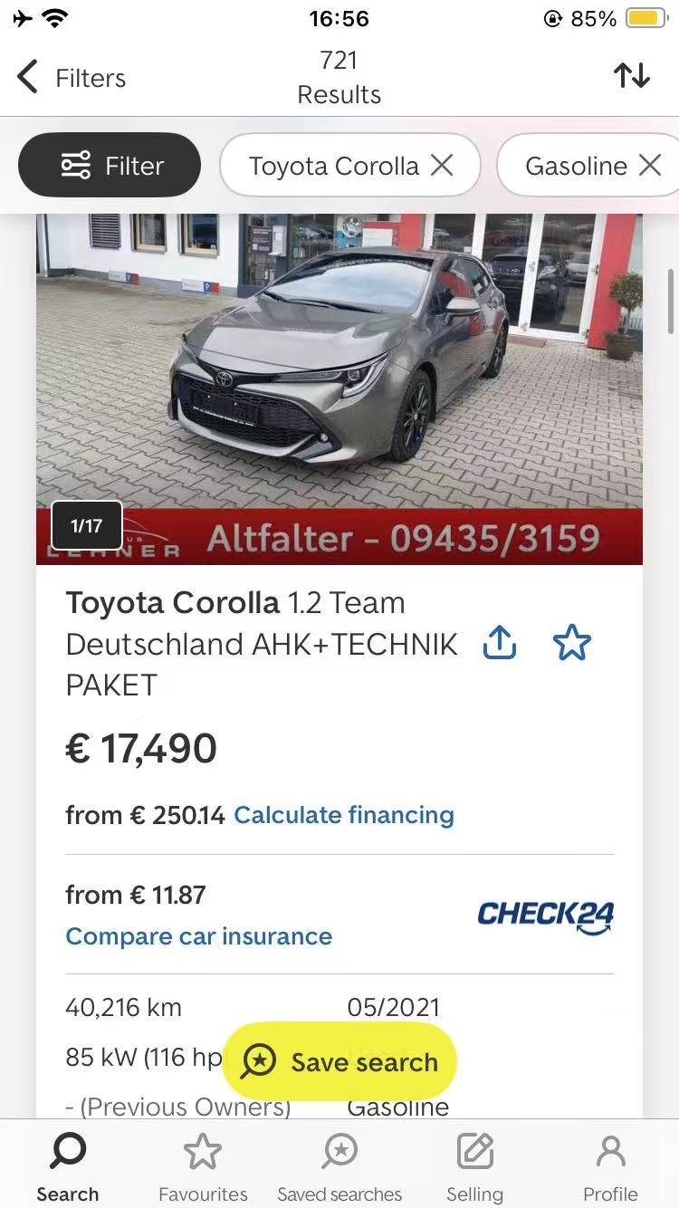
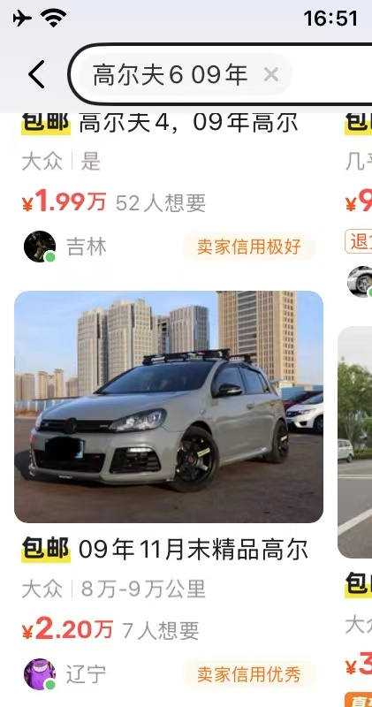
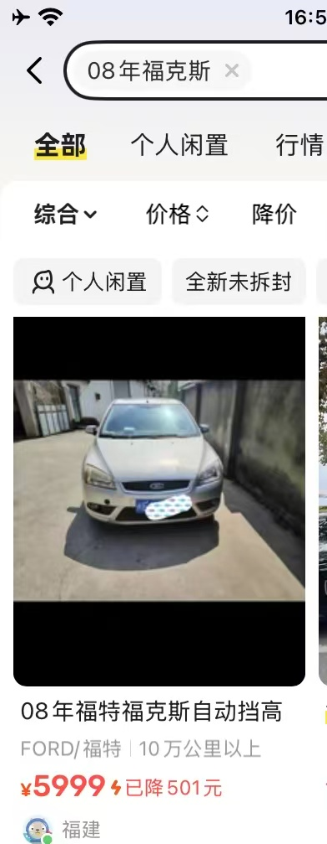
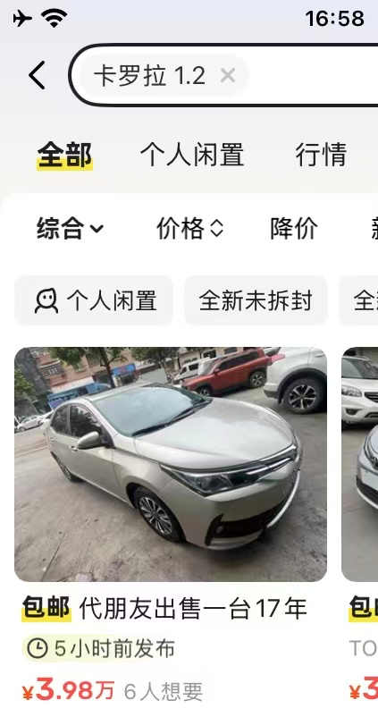
Comparision 1euro=8.15RMB
Comapre the price with the recommendations,I would say your plan will reach sucess under the tax-free policy in Germany.

Slide 17
Thanks for choosing us
Hope you gain great success!

